Slide 1





CASCADE 2025
Advanced security testing solutions for
Chip Security & Binary Analysis
Expert evaluations
Hardware equipment and tooling
Hands-on courses

Slide 2
Open-source projects available:
github.com/eshard
✉️ scared@eshard.com
estraces
scared

Slide 3

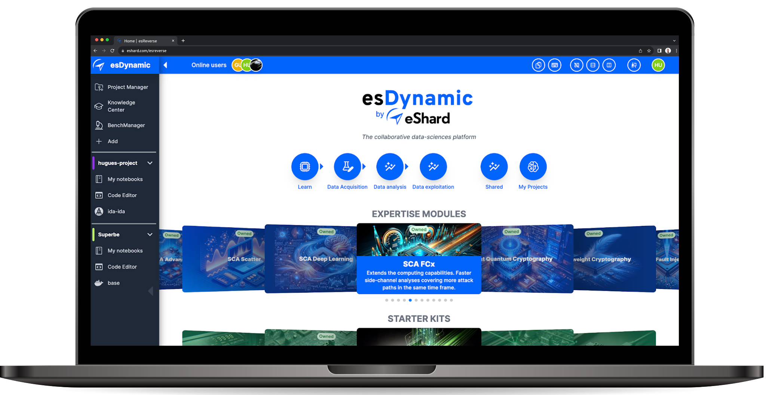

PROJECT MANAGER
KNOWLEDGE CENTER
HARDWARE INSTRUMENTATION
EXTENSIVE COMPUTING
Agnostic | Customizable | Scalable | Collaborative

Slide 4


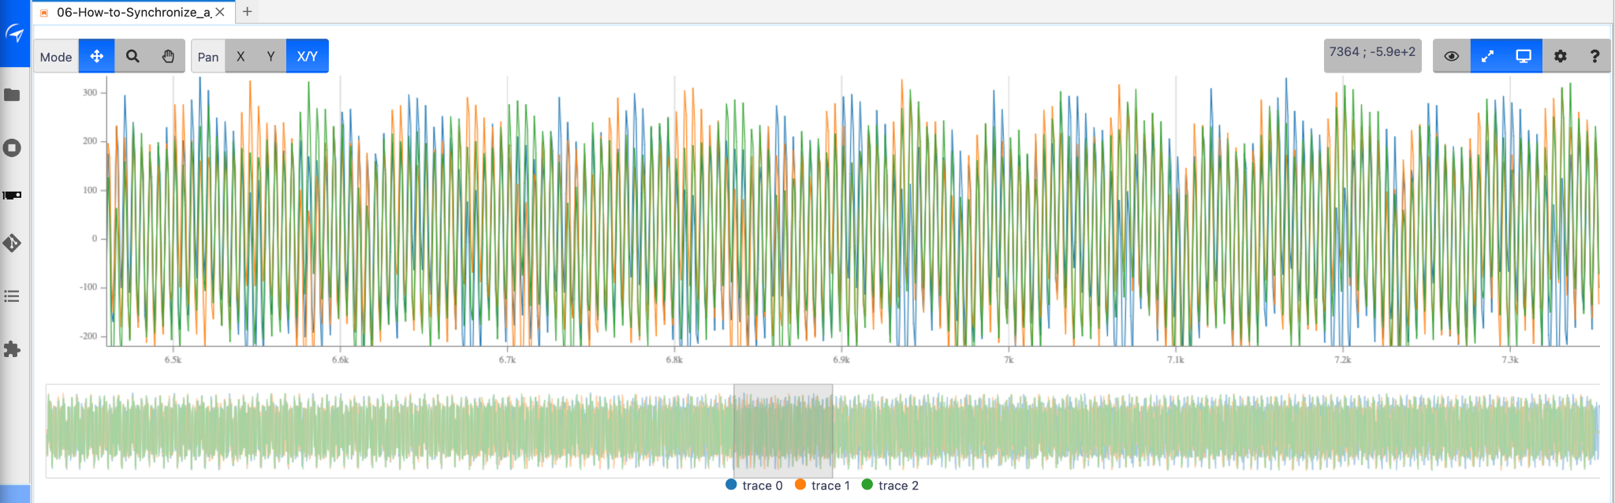

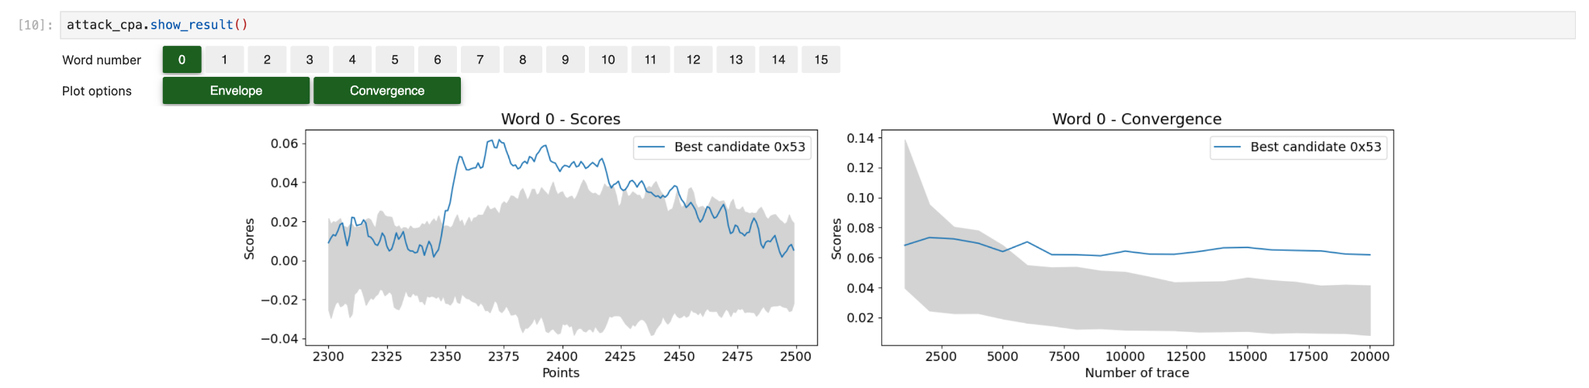
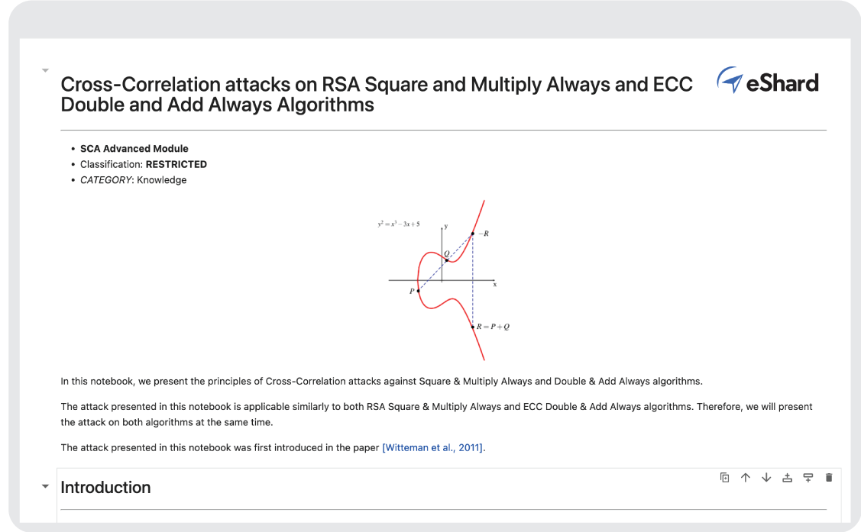
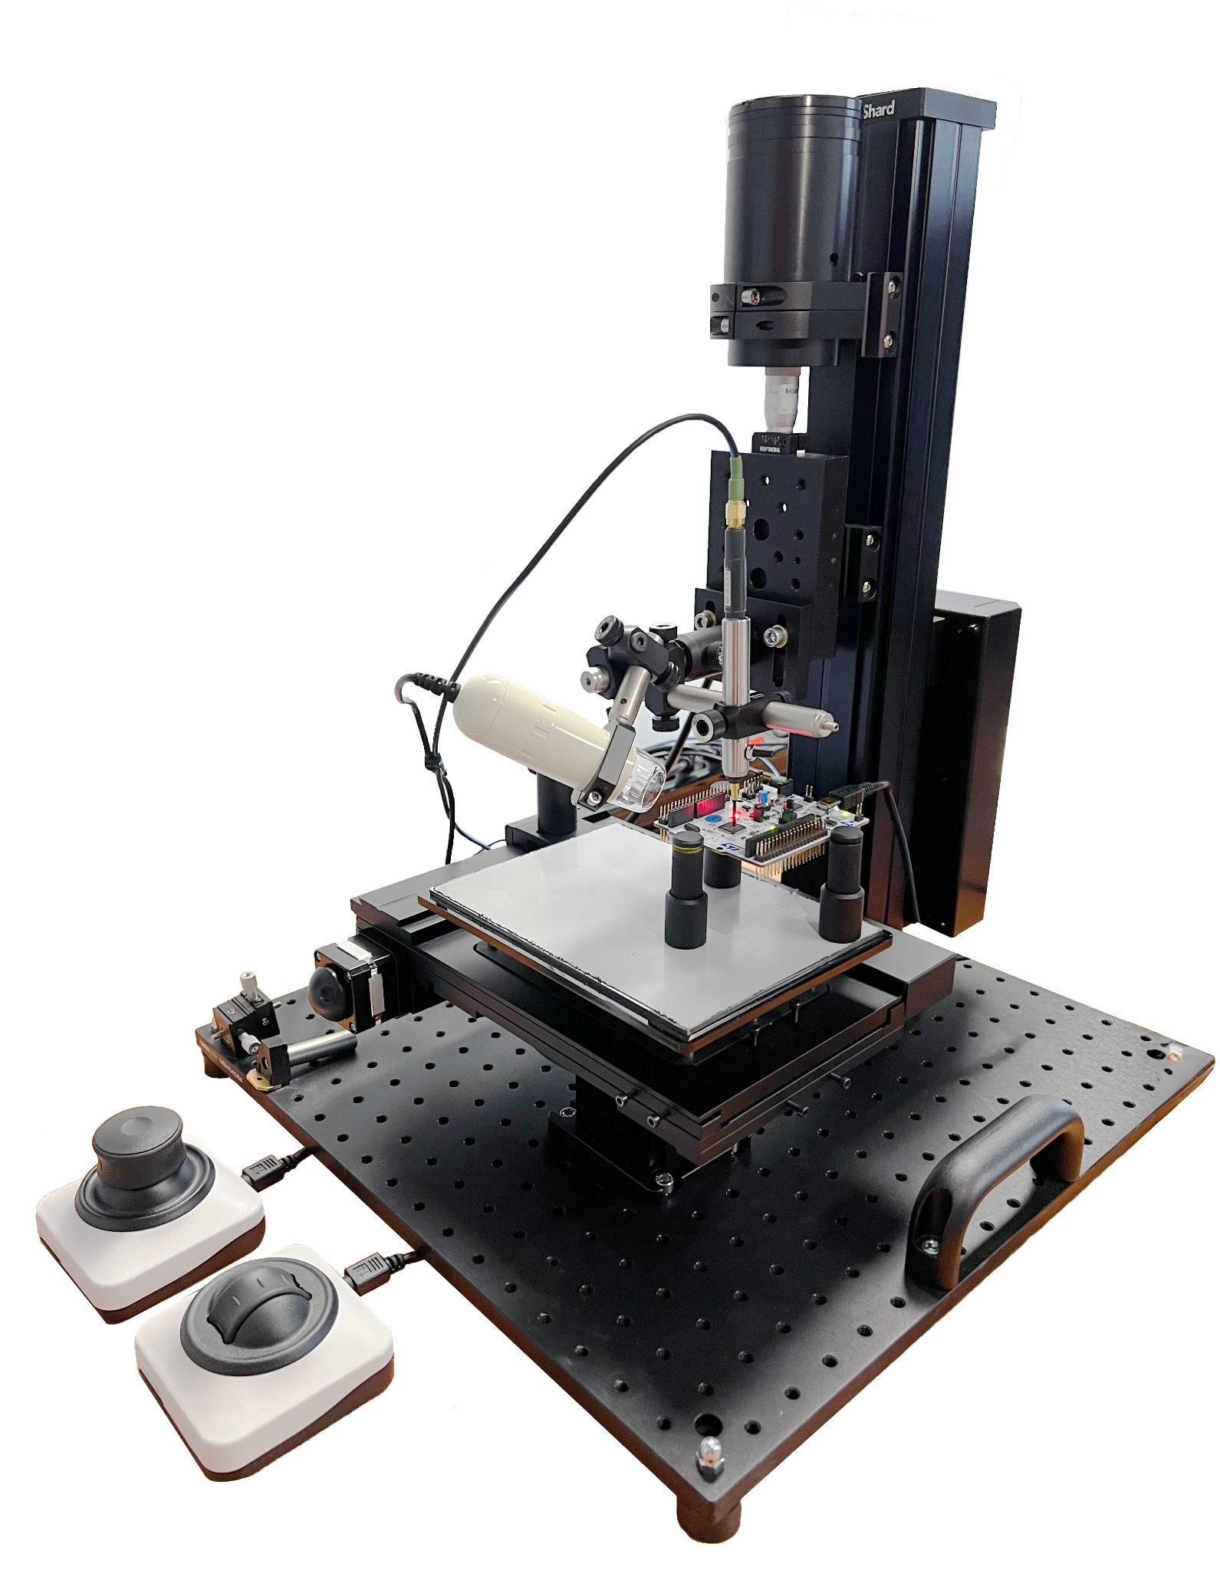
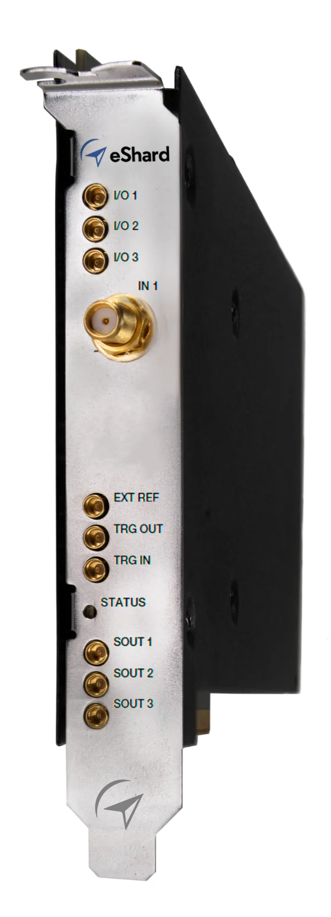

Your entire side-channel analysis workflow from data acquisition to attacks.
Expert tooling
Trace visualisation
Trace synchronisation
Leakage detection
Characterization
Attacks
Reporting

Slide 5
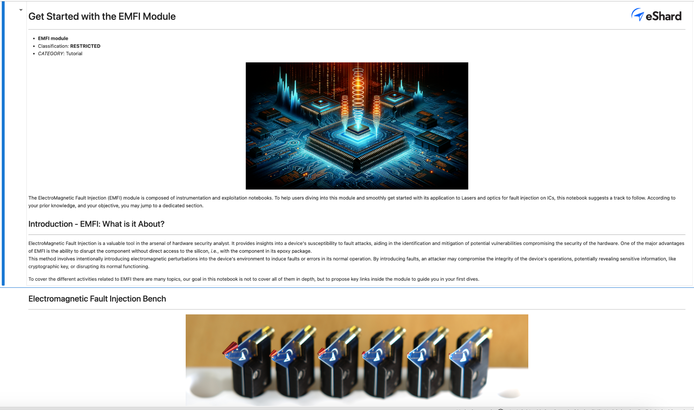
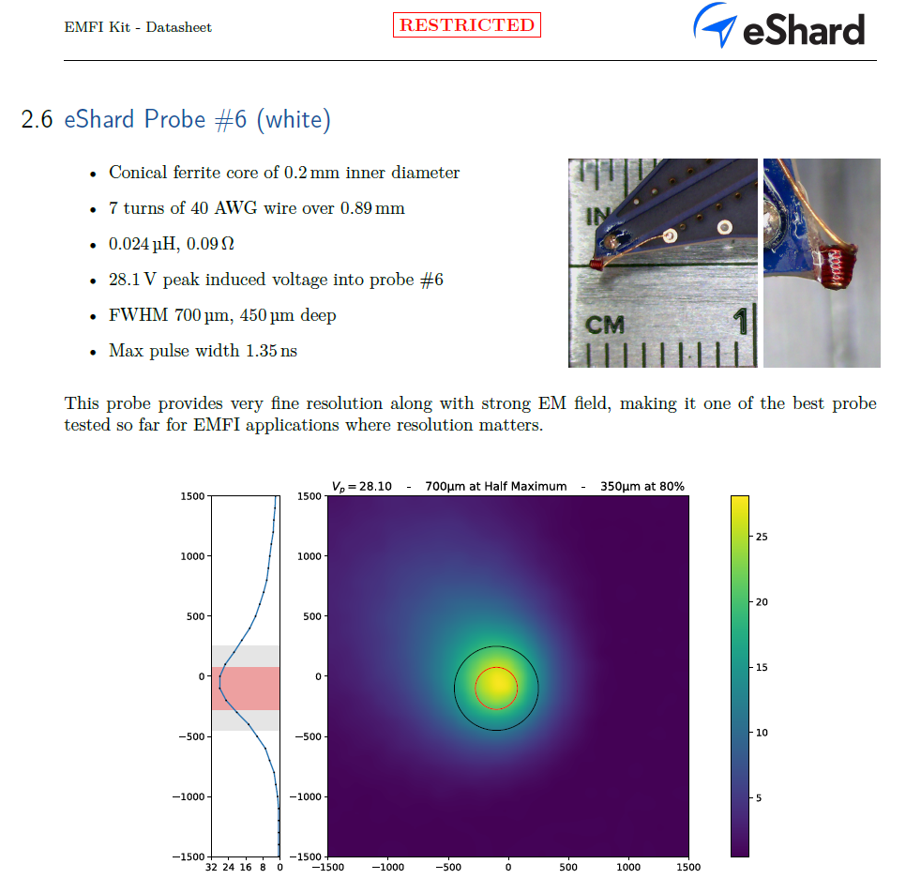
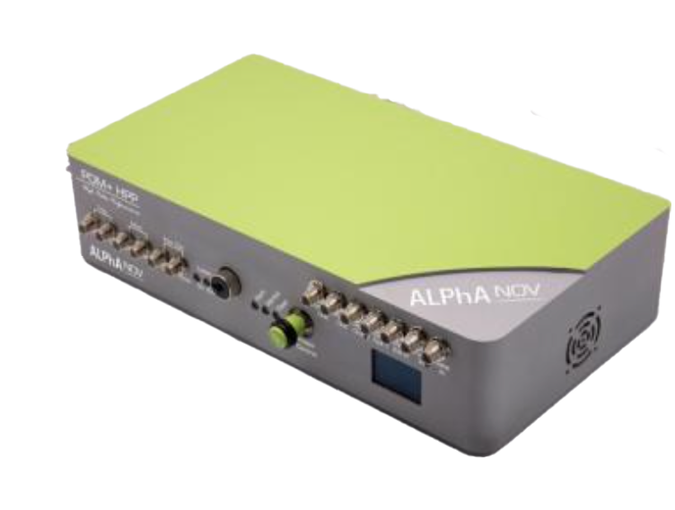
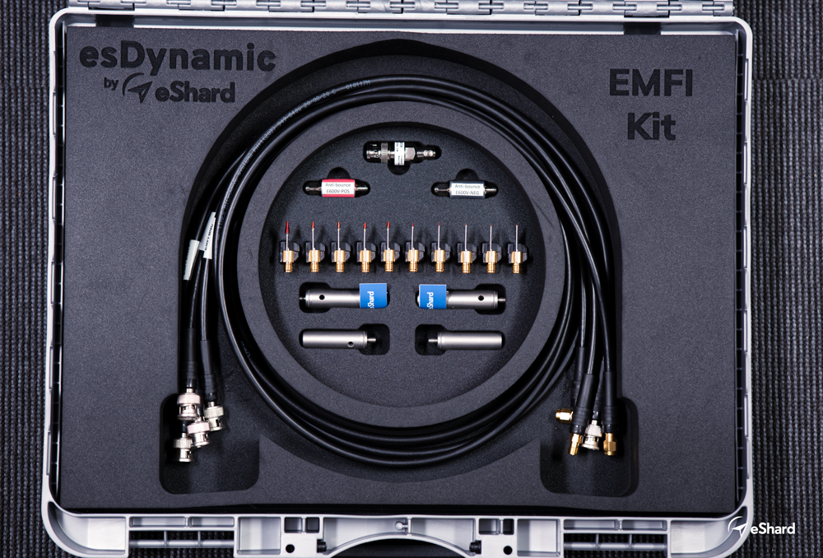
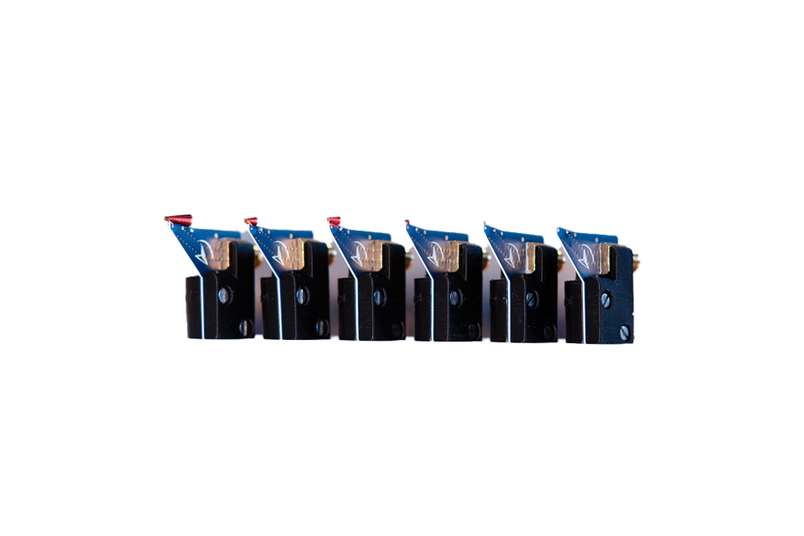

Run the fault injection entire workflow from campaign instrumentation to exploitation.
Expert tooling
Test Engine
Cartography
Fault Characterization
Fault Exploitation
Reporting

Slide 6
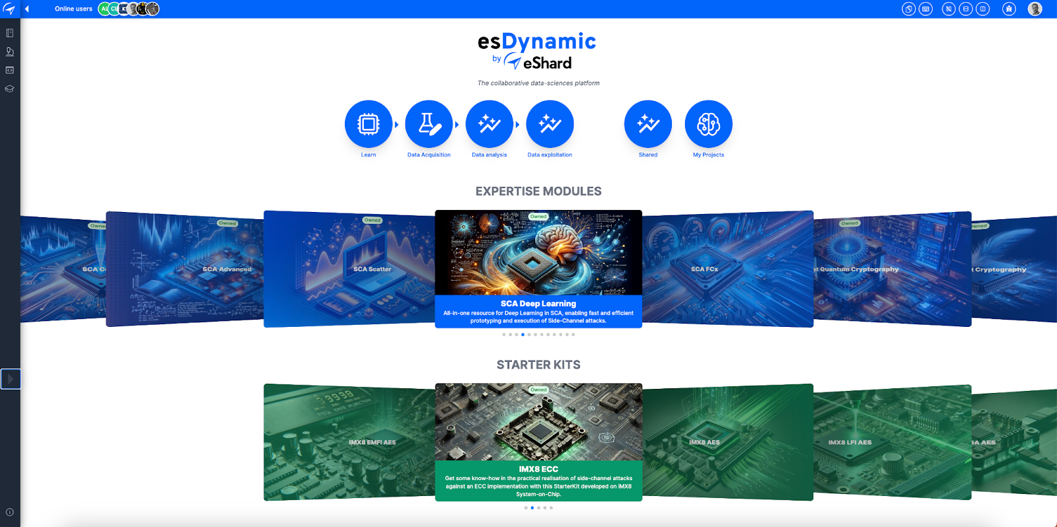
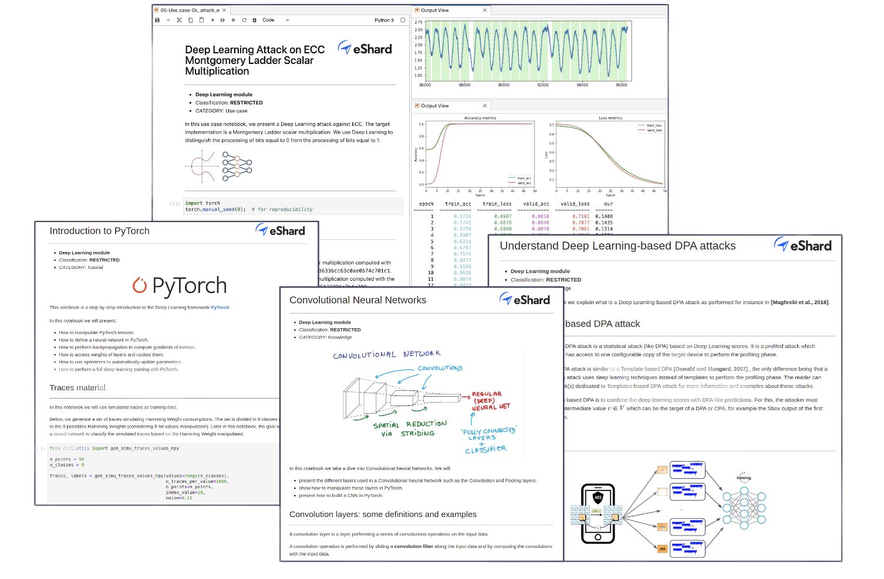
Extensive library of tutorials, use cases, and executable attacks and techniques.
Visit our website to know more
www.eshard.com

